Slide 1
Enhancing K-Means with Preliminary Outlier Detection
Shah Shubham, yash Amin
Guide : Dr. anjali Jivani, dr. hetal bhavsar

Slide 2
Introduction
Popularity of K means algorithm
Simplicity and Intuitiveness, Widespread Familiarity, Ease of Implementation, Deterministic Results, Computationally Efficient, Predictive Convergence
Importance of Outlier Detection in Clustering
Existing Clustering approach for Outlier Detection : DBSCAN algorithm
Problems with Existing Approach

Slide 3
Drawbacks of K means Clustering algorithm
Initial centroid selection (Use KMeans++)
Prior selection of no of clusters (Use Elbow Method or Silhouette Score
Assumption of spherical cluster
Sensitive to Outliers (Use Kmedoid)
Can not handle categorical data (Use Kmedoid)

Slide 4
Selection criteria for K-Means and K-Medoid
K-Means | K-Medoid
Well suited for large dataset | Well suited for small dataset
Affected by Outliers | Robust to Outliers
Can handle only spherical shaped clusters | Can handle non spherical clusters also
Can handle only Numeric data | Can handle Categorical data also

Slide 5
Main Objectives
Research Work
Rectification of Drawbacks of K-Means algorithm
Global Outlier Detection
Local Outlier Detection ( If possible)
Identification of Arbitrary shaped cluster
Selection between K-Means and K-Medoid clustering algorithm
Analyze the density effect i.e. Sparse cluster and Dense cluster on outliers

Slide 6
Tools and Technologies Used
Programming Implementation : Python
Statistical Test Analysis : Python & R Programing
Data Analysis and Preprocessing : Pandas
Scatter Plot Analysis : Matplotlib & Seaborn
API : Scikit Learn
Editor : VS Code and Jupyter Notebook
Synthetic Data Generation : Numpy & Sklearn

Slide 7
Literature Survey
Modifications done to existing KMeans algorithm
Analysis of Univariate Normality Tests
Analysis of Multivariate Normality Tests
Analysis and Evaluation of Outlier Detection methods for data following Normal Distribution
Analysis and Evaluation of Outlier Detection for data not following Normal Distribution

Slide 8
Two-phase Clustering Process for Outliers Detection
Phase 1: Initial Clustering
1. Modified k-means (clusters more than k)
2. Heuristic for New Cluster Centers (new pattern distant away)
3. Cluster Composition (all points in cluster outlier or non-outlier)
Phase 2: Outlier Identification
1. Construction of Minimum Spanning Tree (MST)
2. Outlier Selection (Longest edge cut down)
3. Iterative Refinement (until k achieved)

Slide 9
Efficient Algorithms for Mining Outliers from Large Data Sets
Formulation for distance-based outliers that is based on the distance of a point from its nearest neighbor.
We rank each point on the basis of its distance to its nearest neighbor and declare the top points in this ranking to be outlier.

Slide 10
Modified K-Means Clustering with a Density-Sensitive Distance Metric
1. Initialization: Randomly choose k data points from the data set to initialize k cluster centers
2. For any two points xi, xj , compute the density-sensitive distance determined in the paper.
3. Each point is assigned to the cluster which the density-sensitive distance of its center to the point is minimum.
4. Recalculate the center of each cluster.
5. Continuation. If no points change categories or the number of iterations has reached the maximum number tmax, then stop. Otherwise, go to step 2.

Slide 11
Existing and Popular Approach for Outlier Detection in Data
Z-Score Normalization if the Data is following Normal Distribution
Inter Quartile Range if the Data is not following Normal Distribution
Problem : Both methods can be applicable to only single dimensional data but what about multi-dimensional data ?
Solution : Search for some other methods for outlier detection which can be applicable to multi-dimensional data based on data distribution

Slide 12
Task 1 : Check Normality of Data
Single Dimension data : Univariate Normality
Multi Dimension data : Multivariate Normality
As data is dynamic visualization of data is not allowed so it is required to perform statistical tests on data to whether the data is normally distributed or not ?
Hypothesis of Statistical Test
H0 : Data is following univariate/multivariate normal distribution
H1 : Data is not following univariate/multivariate normal distribution

Slide 13
Tests considered for Univariate Normality
Anderson Darling Test
Kolmogorov Smirnov Test
Shapiro Wilk Test
Lilliefors Test
Jarque Bera Test
D’Agostino’s K^2 Test

Slide 14
Tests considered for Multivariate Normality
Mardia’s Skewness and Kurtosis Test
Henze - Zirkler Test
Royston’s Test
Doornik Hansen Test
Shapiro Wilk Test
Energy Test
Jarque Bera Test
Lilliefors Test

Slide 15
Experiments performed for Normality of Data
Apply the different statistical tests for univariate normality and multivariate normality to different synthetic data and evaluate them at 95 % significance level
Datasets considered : Data following Normal Distribution and Data not following Normal Distribution
Data Size : 50000 data points for single dimensional data and ( 10000, 10 ) for multi-dimensional data
Outcome : Correct or Incorrect i.e. Data is normally distributed and pvalue < 0.05 then outcome is correct and vise-versa.
Report Link : ..\Reports\Univariate Normality Analysis.docx , ..\Reports\Multivariate Normality Analysis.docx

Slide 16
Sample Observation
Table 1 : Univariate Normality Analysis on Normal Data
Table 1 : Multivariate Normality Analysis on Non-Normal Data
Test | Outcome | Time Taken ( in ms)
Anderson Darling Test | Correct | 11.97
Shapiro Wilk Test | Correct | 9.972
Kolmogorov Smirnov Test | Correct | 12.962
Jarque Bera Test | Correct | 3.802
Lilliefors Test | Correct | 6.983
D’Agostino’s K² Test | Correct | 3.953
Test | Outcome | Time taken (in sec)
Mardia’s Skewness and Kurtosis Test | Correct | 6.372
Henze-Zirkler Test | Correct | 9.487
Royston’s Test | NA | NA
Doornik Hansen Test | Correct | 0.392
Energy Test | NA | > 30 min
Shapiro Wilk Test | Correct | 0.0229
Jarque Bera Test | Correct | 0.0069
Lilliefors Test | Correct | 0.058

Slide 17
Time Complexity Analysis for Univariate Normality Test
Time taken by statistical test along with its outcome is measured for synthetic dataset having very large size ( 5 x 10^7 – 10 x 10^7)
Observation :
Jarque Bera test is taking least time among all the tests
Shapiro Wilk test failed ( giving incorrect outcome ) for large size datasets
Outcome : Shapiro Wilk test should not used for normality Analysis
Question : Whether Jarque Bera test should be considered or not ?
Report Link : ..\Reports\Time Complexity Analysis of Normality Test.docx

Slide 18
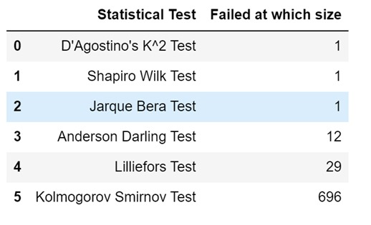
Effect of Skewness and Kurtosis on Univariate Test
Experiment : Imputing data points in normally distributed data ( size : 50000 ) which increases the tailedness of data distribution
Observation on High Tailedness : ( Data points imputed between -10 to 10)
Table 1 : Analysis of Statistical Tests on Outliers

Slide 19
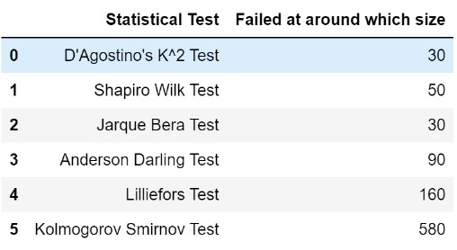
Observation on Low Tailedness : ( Data points imputed between -4 to 4 )
Table 2 : Analysis of Statistical Tests on Outliers
Analysis of Statistical Tests for Normality : ..\Reports\Analysis of Statistical Tests for Normality.docx
Conclusion : Consider Anderson Darling test for Univariate Normality Analysis

Slide 20
Effect of Dispersion of data on Statistical Tests
Experiment : Generated Normally distributed data having high value of standard deviation i.e. > 1 and then check statistical tests are giving correct outcomes or not
Observation : All the statistical tests passed i.e. Correct outcome regarding normality of data
Reason : As the value of std increases not only mean ( x bar) is affected but observations (xi) is also affected so ultimately it won’t cause in effect in skewness and kurtosis
Conclusion : Statistical tests are not affected by dispersion of data ( Standard Deviation)

Slide 21
Selection of Statistical Test for Multivariate Normality
Total Available Statistical Tests : 8
Statistical Tests to be considered :
Shapiro Wilk Test
Jarque Bera Test
Doornik Hansen Test
Lilliefors Test
According to R programming documentation performance of Lilliefors test is worse than Anderson darling test

Slide 22
Time Complexity Analysis of Multivariate Normality Tests
Time taken by statistical test along with its outcome is measured for synthetic dataset having very large size ( (2.5 x 10^5,5) – (5 x 10^6,25))
Observation :
Jarque Bera test is taking least time among all the tests
Shapiro Wilk test failed ( giving incorrect outcome ) for large size datasets
Outcome : Shapiro Wilk test should not used for normality Analysis
Question : Whether Jarque Bera test should be considered or not
Report Link : ..\Reports\Time Complexity Analysis of Normality Test.docx
Conclusion : Consider Doornik Hansen Test for Multivariate Normality Analysis

Slide 23
Selection of Outlier Detection algorithm for Multi Dimensional Data not following Normal Distribution
Existing Algorithms :
IQR ( Only 1D)
Isolation Forest
Local Outlier Factor
One Class SVM
Experiment Performed : Datasets having labeled outlier have obtained and these algorithms are evaluated based on % of outliers detected, Precision and Recall
Dataset Resource : ODDS Datasets

Slide 24
Observation on algorithms detecting outliers in Non Normal data
Isolation Forest
works well among all the algorithms for detecting global outliers from data
Problem : False Positives when Contamination is ‘auto’
Local Outlier Factor
Works well for identifying local outliers of respective clusters
Problem : Parameter n_neighbors is required to be tuned otherwise it may not work well
One Class SVM
Unable to properly identify outliers from data
Reason : Tries to create hyperplane which separates regular data points and outliers
Report : ..\Reports\Outlier Analysis on Labeled Outlier Data.docx

Slide 25
Sample Observation
Algorithm | Parameters | TP | FP | TN | FN | Precision | Recall
Isolation Forest | Contamination = ‘auto’ | 2392 | 37125 | 246176 | 355 | 0.869 | 0.871
 | Contamination = 0.009 | 233 | 2342 | 280959 | 2514 | 0.983 | 0.085
Local Outlier Factor | Contamination = 0.009, n_neighbors = 20 | 125 | 2450 | 280851 | 2622 | 0.982 | 0.046
 | Contamination = ‘auto’, n_neighbors = 20 | 51 | 847 | 282454 | 2696 | 0.988 | 0.019
 | Contamination = 0.009, n_neighbors =50 | 104 | 2471 | 280830 | 2643 | 0.982 | 0.038
 | Contamination = 0.009, n_neighbors =100 | 114 | 2461 | 280840 | 2633 | 0.982 | 0.041
One Class SVM | Kernel = ‘linear’, Nu = 0.009 | 1376 | 1198 | 282103 | 1371 | 0.991 | 0.501
 | Kernel = ‘rbf’, Nu = 0.09 | 188 | 2387 | 280914 | 2559 | 0.983 | 0.068

Slide 26
Selection of Outlier Detection Algorithm for Multidimensional Data following Normal Distribution
Existing Algorithms :
Mahalanobis Distance with Outlier Detection
Elliptic Envelope
Minimum Covariance Determinant
Experiment Performed : 2D normally distributed data is generated and outliers are observed for different value of contamination
Observation : Same outliers are given by all the methods for specific value of contamination
Report : ..\Reports\Outlier Analysis for Normal Data using Scatter Plot.docx
Question : Which method should be selected among these ?

Slide 27
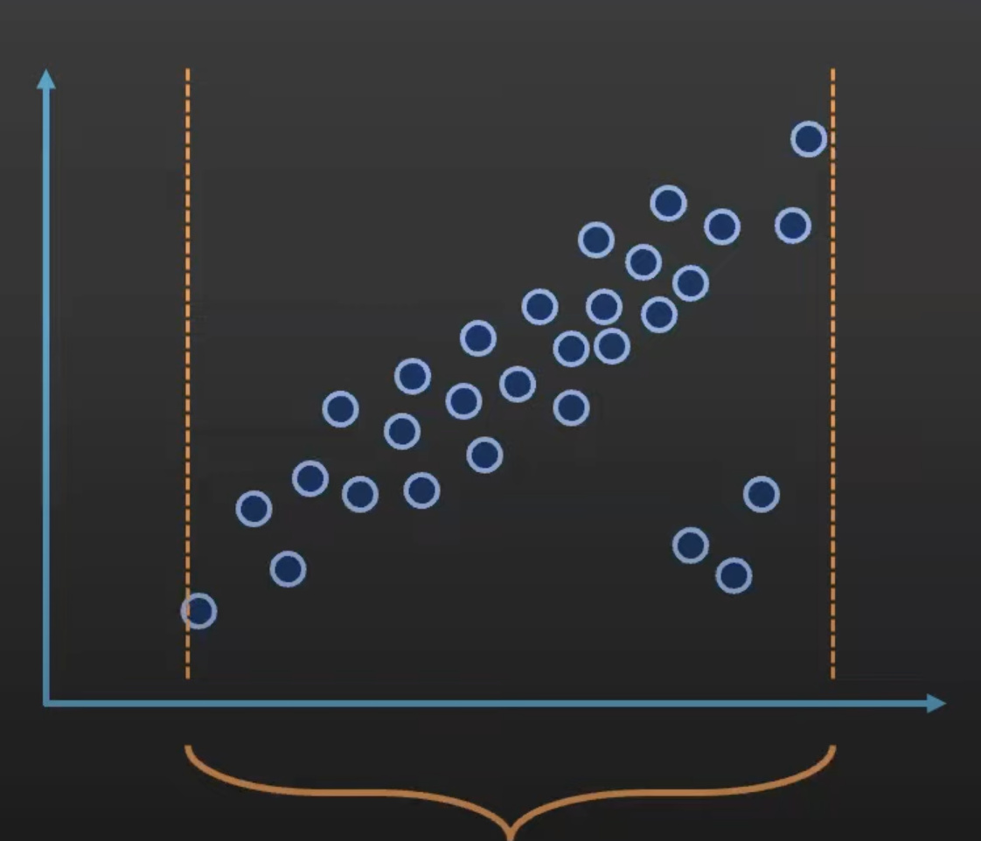
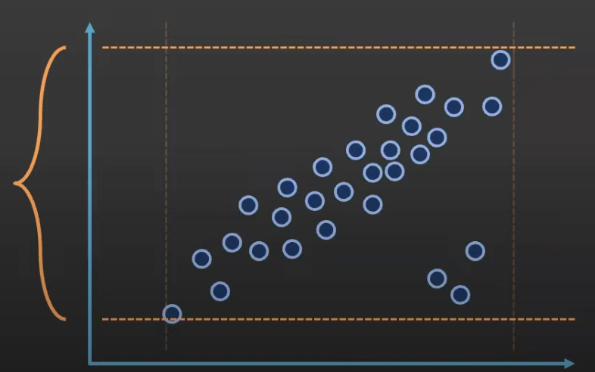
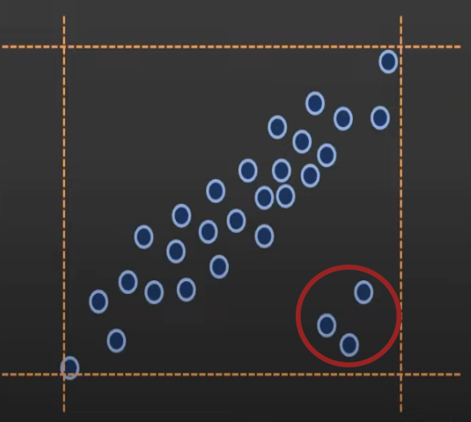
Detecting outliers
Taking both X-axis and Y-Axis
Taking only X-axis
Taking only y-axis

Slide 28
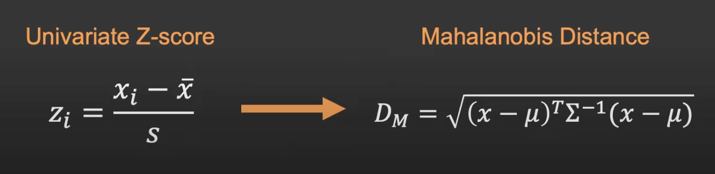
Mahalanobis Distances
Generalization of z-scores to multi-dimensional space.
• Replace univariate mean with multivariate mean
• Replace standard deviation with covariance matrix

Slide 29
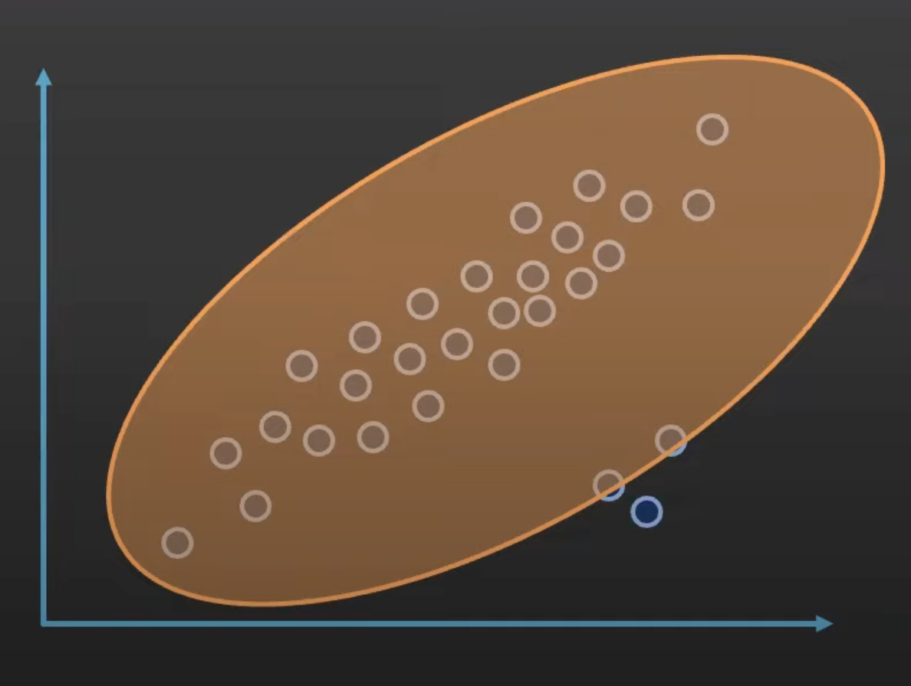
Mahalanobis distance for outlier detection and Elliptic Envelope both techniques are affected by outliers Why ?
Mahalanobis distances use multivariate mean and covariance matrix which are influenced by outliers.
Internally Elliptic Envelope uses Mahalanobis distance.
By fitting the ellipse to the data, Elliptic Envelope flags Data points lying outside the ellipse as outliers.

Slide 30
Further study on Outlier Detection Techniques for Normally distributed data
Mahalanobis distance for outlier detection and Elliptic Envelope both techniques are affected by outliers . Why ?
Minimum Covariance Determinant is robust to outliers in data . Why ?
Conclusion : Consider MCD algorithm for outlier detection when the data is following Multivariate Normal distribution

Slide 31
Approach for Outlier Detection
Algorithm Flowchart :
Data Dimension
Single Dimension
Yes
No
Distribution
Distribution
Normal
Non Normal
Normal
Non Normal
Z score
IQR
MCD
Isolation Forest

Slide 32
Effect of Density of Clusters on Isolation Forest
Case : Data is clustered in such a way that their exist dense and sparse cluster together i.e. Some clusters are dense and some are sparse
Question : Which data points will considered as global outliers ?
Problem : It may be possible that outlier detection algorithm applied on this data may return those data points as outliers which are part of sparse cluster rather than the actual global outliers of data
Experiment Performed : Data generated having Dense cluster and Sparse cluster and outliers given by specific value of contamination is observed
Outcome : Isolation Forest is robust to cluster density

Slide 33
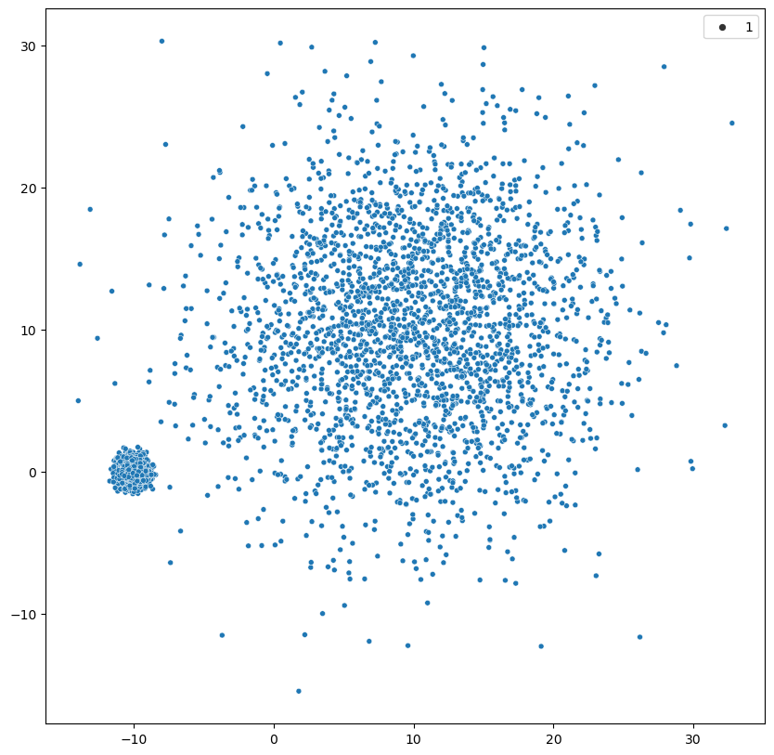
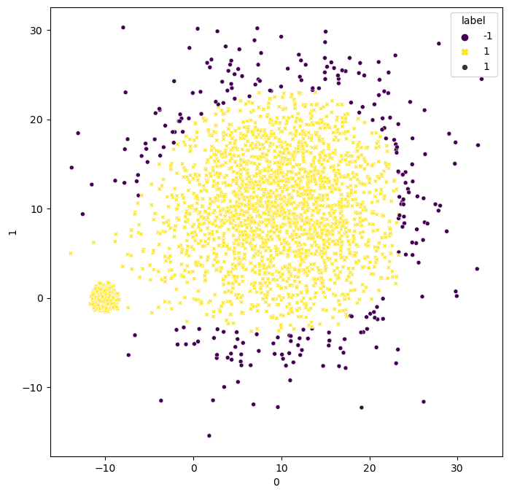
Observation on varying Cluster Density
Fig.1 : Scatter Plot of Data
Fig.2 : Outliers given by Isolation Forest

Slide 34
Functionalities of Modified Algorithm
Automatic selection of K value using Silhouette Score
Only Outlier Detection without Clustering
Implemented Hopkins Statistics to check whether the data can be clustered or not after removing outliers from data

Slide 35
Revised Statistical Approach
Before KMeans Clustering everything remains same
Apply Hopkins Statistics on filtered data having no Contamination
If value of Hopkins Statistics < 0.5 :
Data Can not be Clustered
Else :
After removing outliers from data find the silhouette score for different values of K and K value having highest silhouette score will be optimal K and KMeans algorithm will be applied to data with that optimal K value

Slide 36
Comparison between Suggested Approach and Existing Approach
Existing Approach : Use DBSCAN algorithm to identify outliers and after perform clustering
Problem with DBSCAN : 2 hyperparameters required to be tuned i.e. MinPts and Epsilon
Advantage with suggested approach : Automatic Selection of K value , Only contamination value is needed ( If known )
DBSCAN is density based approach i.e. Existence of varying density cluster may result in False Outliers but this is not the case with Isolation Forest

Slide 37
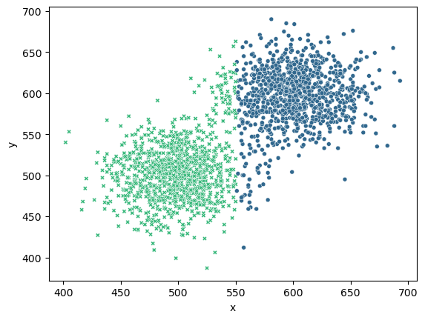
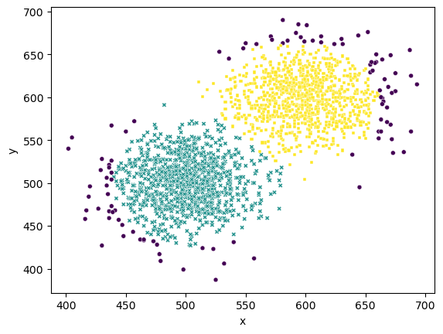
Evaluation of Proposed Method
Fig. 3 : Clusters of Original Data by KMeans
Fig. 3 : Outliers Detected by Proposed Method at 5 % Contamination

Slide 38
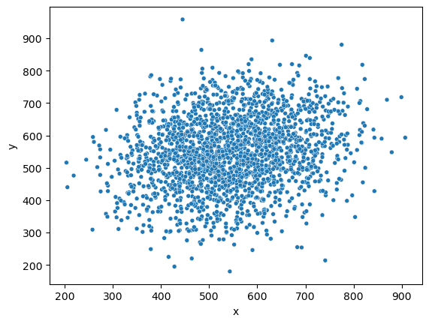
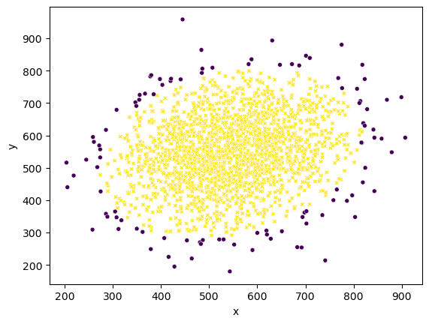
An Application of added Functionality
Fig. 5 : Scatter Plot of Original Data
Fig. 6 : Outliers Detected by Proposed Method

Slide 39
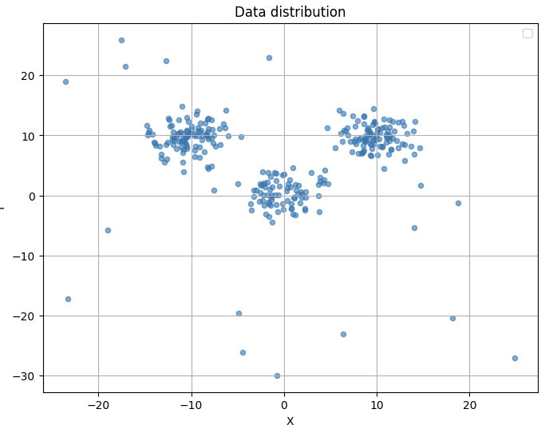
1) Check the Distribution of data before applying the enhanced kmeans approach.
An Extension of Proposed Method

Slide 40
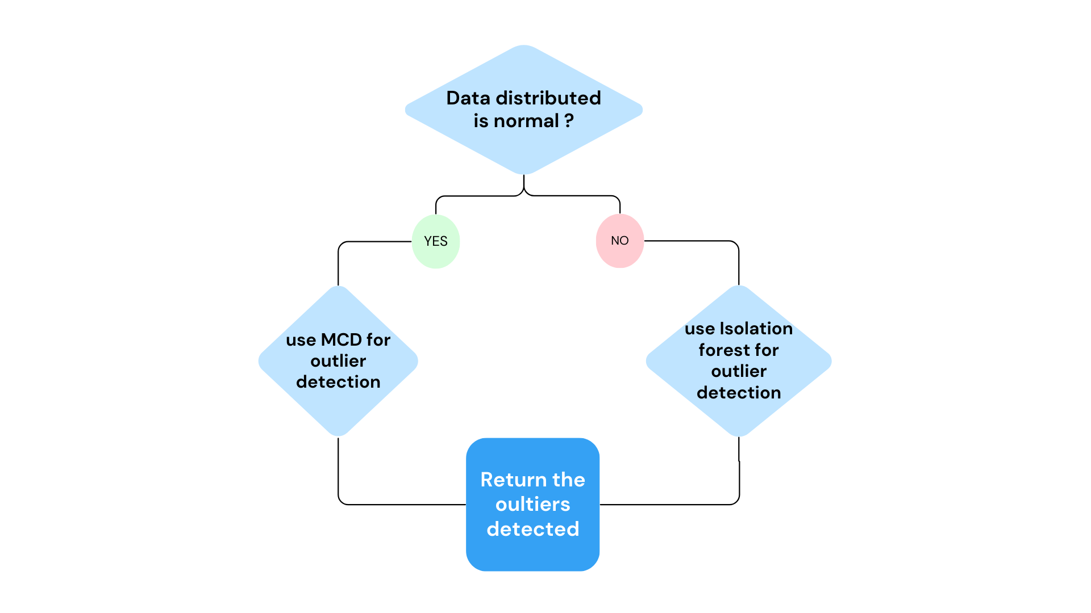
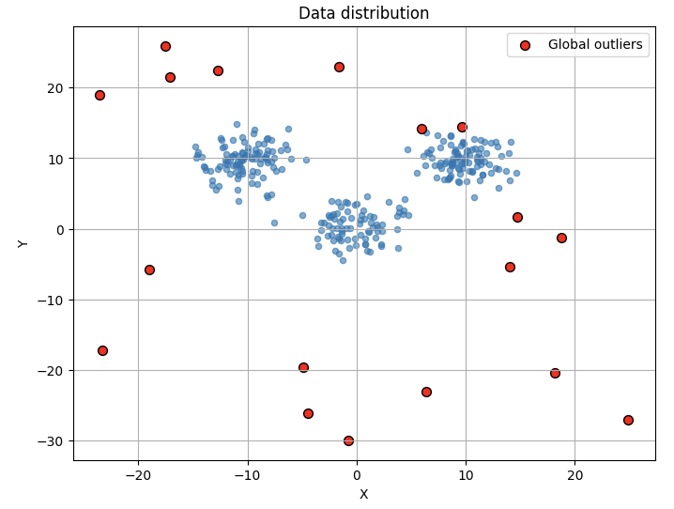
2) Detection and removal of global outliers.

Slide 41
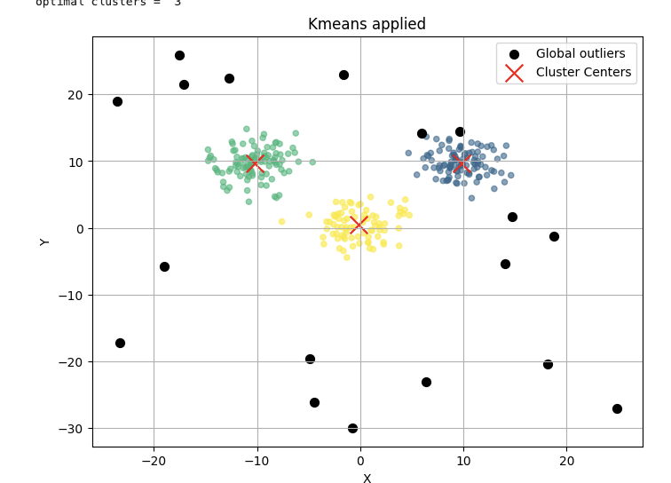
3) Applying kmeans on the data after removing the global outliers.

Slide 42
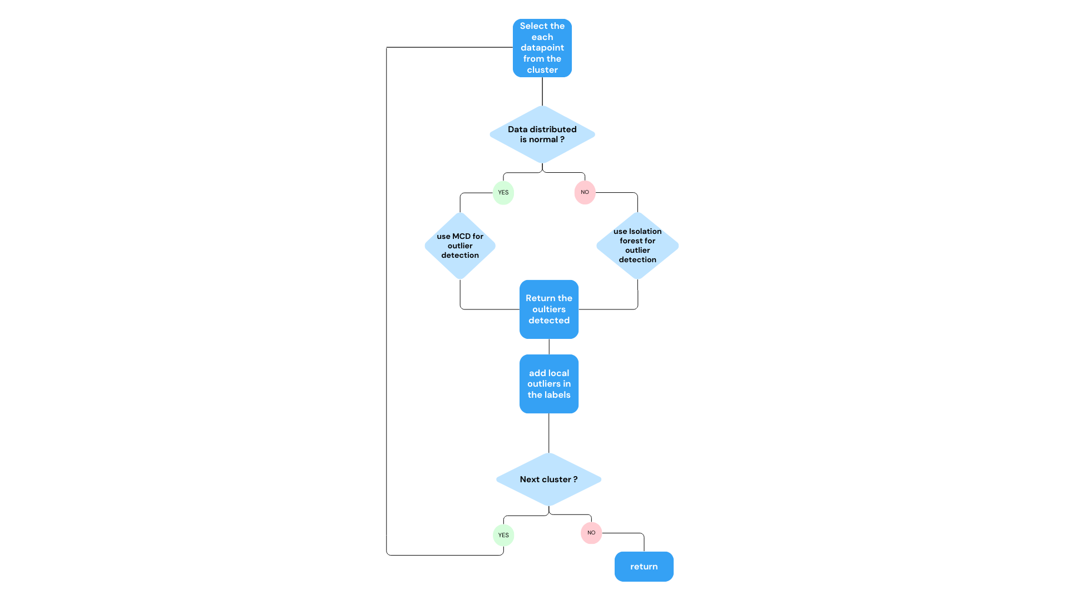
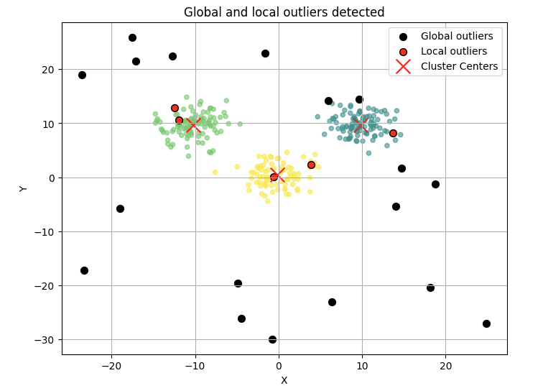
4) Local outliers detected from each cluster and returned with label as
-2 for clarity.

Slide 43
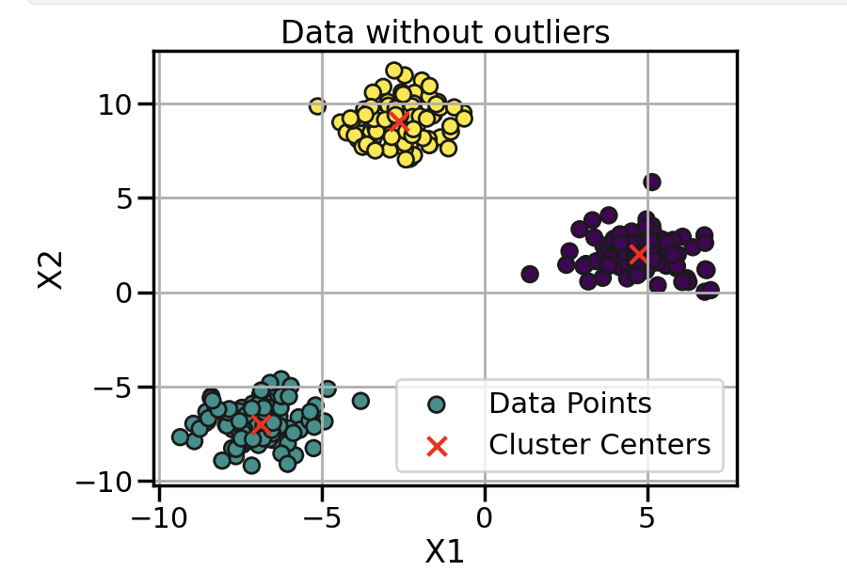
Advantage of the proposed method
The scatter plot denotes the data
when there are no outliers and
cluster centers are properly at
centers of the cluster.
The addition of outliers to the data causes the cluster centers to shift, leading to a situation where data points might end up being assigned to the wrong cluster

Slide 44
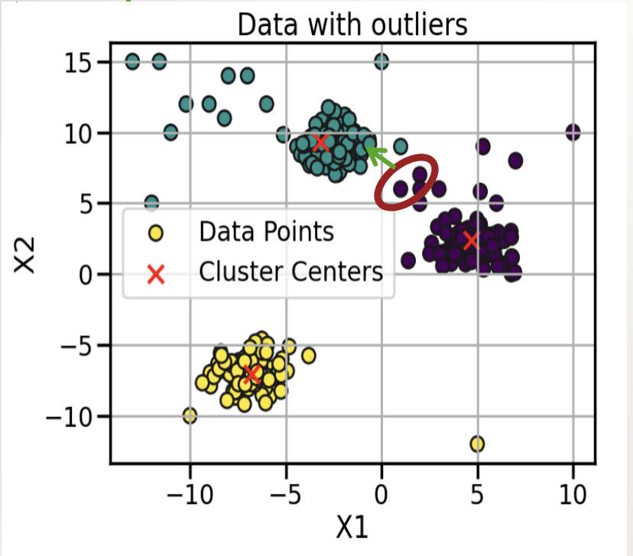
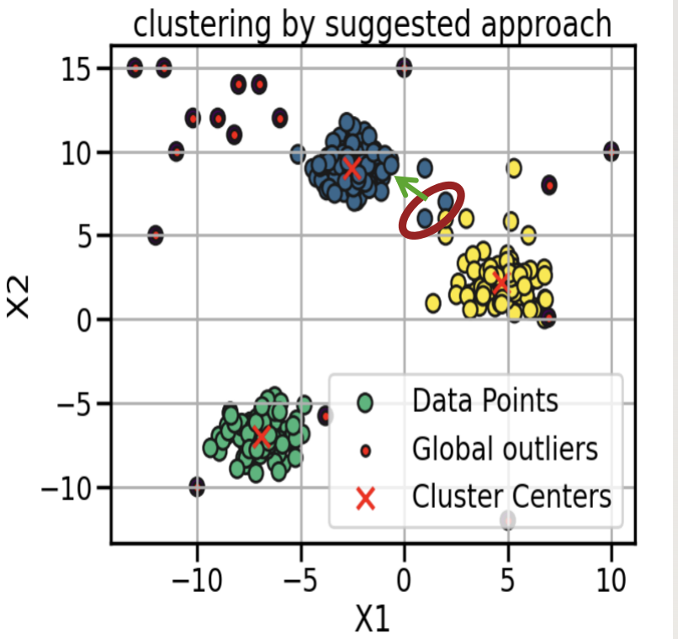
These two points should belong to the green
cluster and not in purple but due to outliers they are incorrectly classified.
These two points are correctly classified after detecting and removing the outliers.

Slide 45
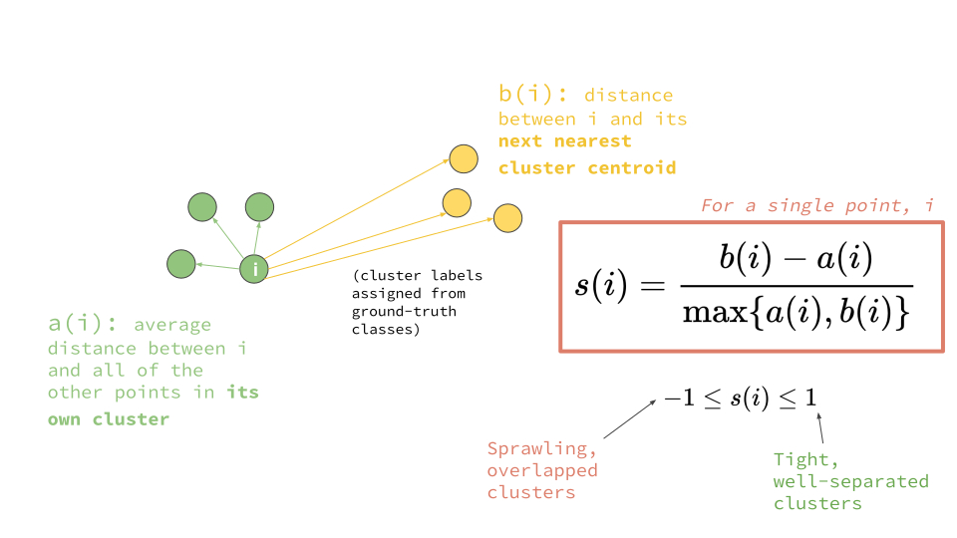
Evaluation of clustering quality?
a(i) = cohesion
b(i) = separation
The fig shows the silhouette
coefficient for point (i).
The mean of silhouette
coefficient of all data points
is called Silhouette Score.
A silhouette score of 0.5 or higher is considered to indicate a reasonably good clustering.

Slide 46
Results
Silhouette Score
Dataset | Traditional Kmeans | Modified Kmeans
Housing | 0.525246591925985 | 0.595921087660535
Weather | 0.4387507526721906 | 0.5241505737320484
Iris | 0.5528190123564102 | 0.5871637194063823
Wine | 0.5209776312110992 | 0.5955713447901099

Slide 47
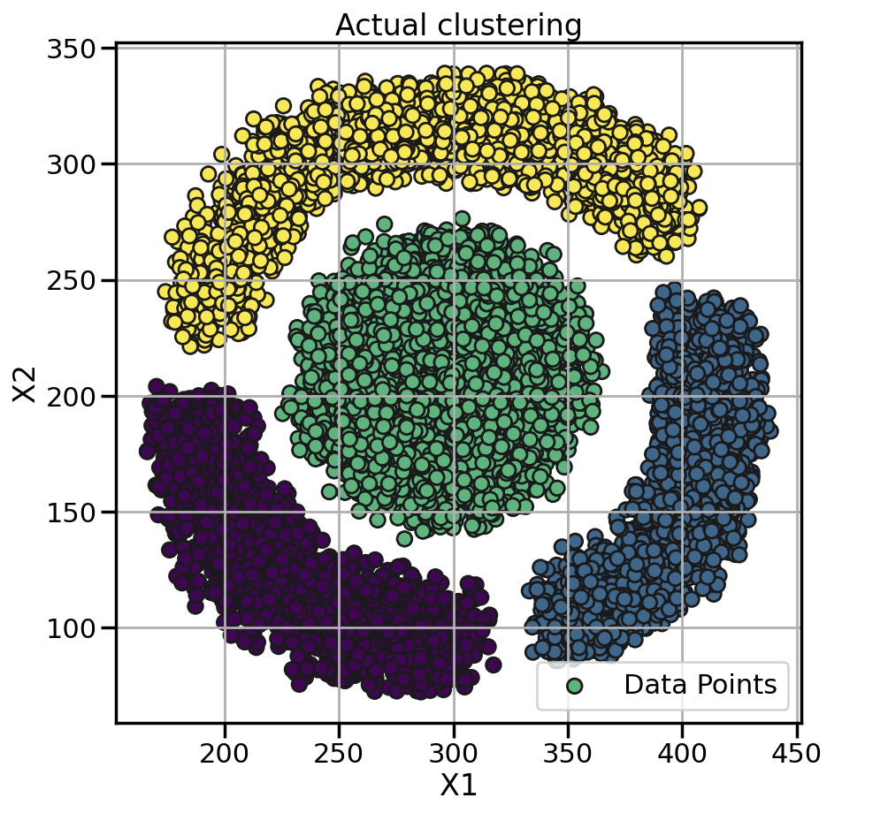
Limitation
The approach encounters difficulties when clustering data characterized by varying cluster densities.
However, despite this, the approach remains valuable for effectively identifying outliers within the dataset, particularly through the utilization of isolation forests.

Slide 48
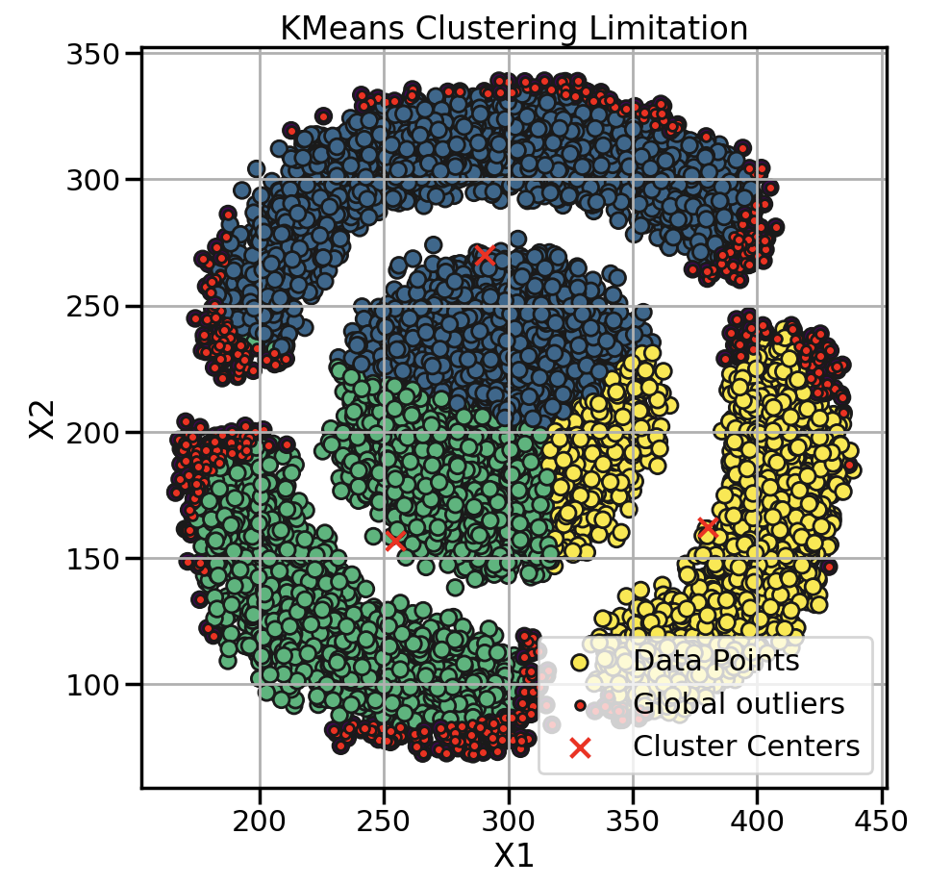
The clusters formed are not appropriate and the centers of clusters are not in place due to varying density though it can be visualised that global outliers are correctly detected.

Slide 49
Future Enhancements
Integration of Deep Learning Techniques : Explore the integration of deep learning models for outlier detection and clustering.
Dynamic Contamination Rate Adaptation: Develop algorithms that dynamically adapt the contamination rate based on the characteristics of the data.
Ensemble Methods : Combining multiple outlier detection algorithms or clustering algorithms.
Interactive Visualizations : Develop interactive visualization tools

